Slide 1
ENSE 496ab, Milestone 4
!Cool
Team Members:
Christian John
Ahmed Shamiss
Jeremy Cross
Evan Geissler
Taylen Jones
Dakota Fisher
15th November, 2018

Slide 2
Team !Cool
We are team !Cool and and our group members are:
Christian John
Ahmed Shamiss
Jeremy Cross
Evan Geissler
Taylen Jones
Dakota Fisher
We are assigned to the Weekend Warriors project

Slide 3
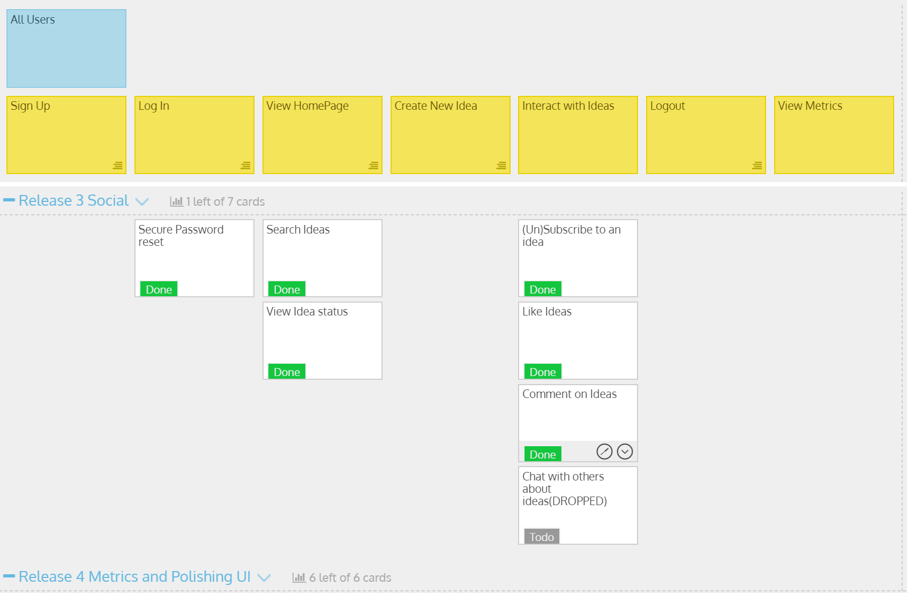
USM Review

Slide 4
DEMO TIME !!!

Slide 5
Comments/Discussion
Successes
Commenting on Ideas
Subscribing to Ideas
Barriers to success?
Liking an idea cause a few issues
The break last week

Slide 6
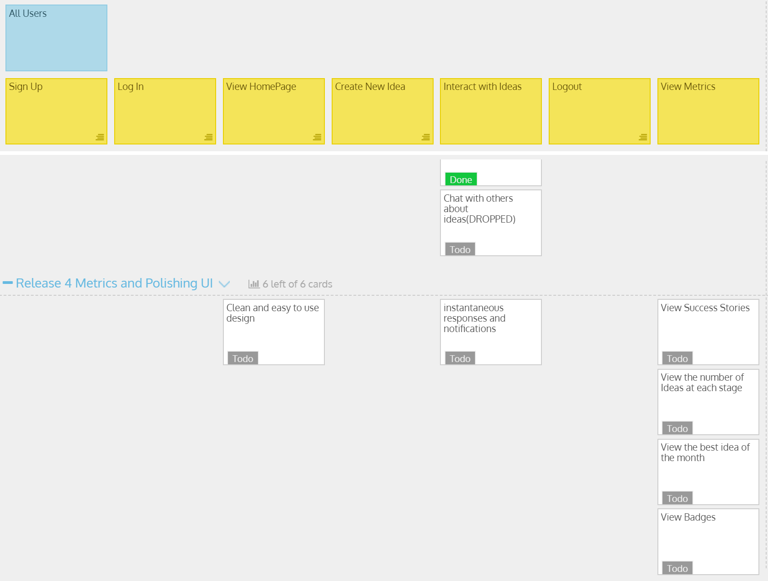
Sprint 4 Deliverables

Slide 7
Usability documentation
Consent Form, Questionnaire:
https://github.com/OmegaHelix/notcool/tree/master/Usability%20Evaluation/Fall%20Term
User Manual:
https://github.com/OmegaHelix/notcool/tree/master/Documentation/User%20Guides

Slide 8
Group reflection
How did you feel about this milestone? What did you like about it? What did you dislike?
Difficulty with the likes system
What did you learn about yourself as you collaborated and worked through this milestone?
Asp.net sucks

Slide 9
Group reflection
How will you use what you have learned going forward?
Polish the UI and styling to make it look more like a finished product
Fill in missing areas in the site
What “stuff & things” related to this milestone would you want help with?
How to call a Controller function Asynchronously

Slide 10
Questions?

